Slide 1

DATA ANALYTICS
TUTORIAL SESSIONS
- Aiman Alam
Data Science

Slide 2
WHAT IS DATA ANALYTICS
Before we go ahead with more concepts on Machine Learning and Artificial Intelligence, let's first learn a bit of Data Analysis, so that you can get a better understanding of data. Every dataset tells you a story if you look at it through the right lenses.
To give you a perspective, imagine that you have data on the number of sales happening in every month of every single shop in your city. You would notice that during the festivals, the sales volume of sweets rises by a tremendous magnitude. Similarly, the sales volume of clothes, jewellery and electronic products also rose significantly in this period.
If you have the tourism data, then you would see that a lot of people in India go on a vacation in the months of May and June, which makes sense because schools are closed in these two months due to summer vacation.
Through data, you can observe a trend and based on that trend you can draw meaningful insights, helping you in making decisions in your daily life, in business organisations, in medical and engineering applications etc.

Slide 3
DATA ANALYTICS
Data analytics is the process of examining, cleaning, transforming, and interpreting data to discover meaningful insights, patterns, and trends that can inform decision-making and solve real-world problems. It involves using various techniques, tools, and technologies to extract valuable information from large and complex datasets. Data analytics encompasses a wide range of activities, including data collection, data preparation, statistical analysis, data visualization, and the application of machine learning and data mining algorithms.

Slide 4
OUR DATASET
Flight Information:
Flight Date and Time: The date and scheduled departure time of each flight.
Airline: The airline carrier operating the flight (e.g., Delta, American, United).
Flight Number: The unique identifier for each flight.
Origin and Destination:
Origin Airport: The airport from which the flight departs (e.g., JFK, LGA, EWR).
Destination Airport: The airport to which the flight is headed.
Flight Performance:
Departure Delay: The amount of time the flight was delayed before departure.
Arrival Delay: The amount of time the flight was delayed upon arrival.
Distance: The distance traveled by the flight.
https://www.kaggle.com/datasets/lampubhutia/nyc-flight-delay

Slide 5
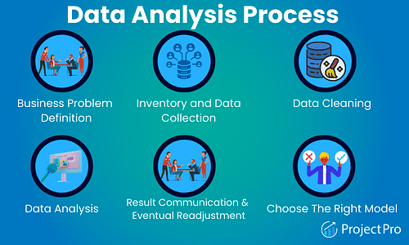
DATA ANALYTICS PROCESS

Slide 6
LIBRARIES
**import pandas as pd:** This line imports the pandas library, which is a powerful library for data manipulation and analysis. It is commonly aliased as pd for convenience in coding.
User Guide — pandas 2.1.0 documentation (pydata.org)
**import numpy as np:** This line imports the numpy library, which provides support for numerical operations and arrays. It is often aliased as np.
What is NumPy? — NumPy v1.25 Manual
**import matplotlib.pyplot as plt:** This line imports the pyplot module from the matplotlib library, which is used for creating static, animated, and interactive visualizations in Python. It is aliased as plt for convenience.
Matplotlib Tutorial (w3schools.com)
**import seaborn as sns:** This line imports the seaborn library, which is built on top of matplotlib and provides a high-level interface for creating informative and attractive statistical graphics. Seaborn is often aliased as sns.
An introduction to seaborn — seaborn 0.12.2 documentation (pydata.org)

Slide 7
DATA CLEANING
Data preprocessing is like getting your data ready for analysis or machine learning. It involves cleaning up messy data, converting it into a format that computers understand, and making sure it's good to go.
Here are some simple steps:
Clean the Data: Remove any mistakes, like missing values or weird numbers.
Organize the Data: Make sure your data is easy to work with, like putting it into rows and columns.
Change the Data: Sometimes, you need to change how the data looks. For example, turning "yes" or "no" into 1s and 0s.
Get Rid of Extra Stuff: If you have too much data, you might want to pick only the most important parts.
Check Everything: Make sure your data is good to go by double-checking it.
Think of data preprocessing like preparing ingredients before cooking. It helps you avoid mistakes and makes it easier to create something delicious (in this case, insights or predictions) from your data.

Slide 8
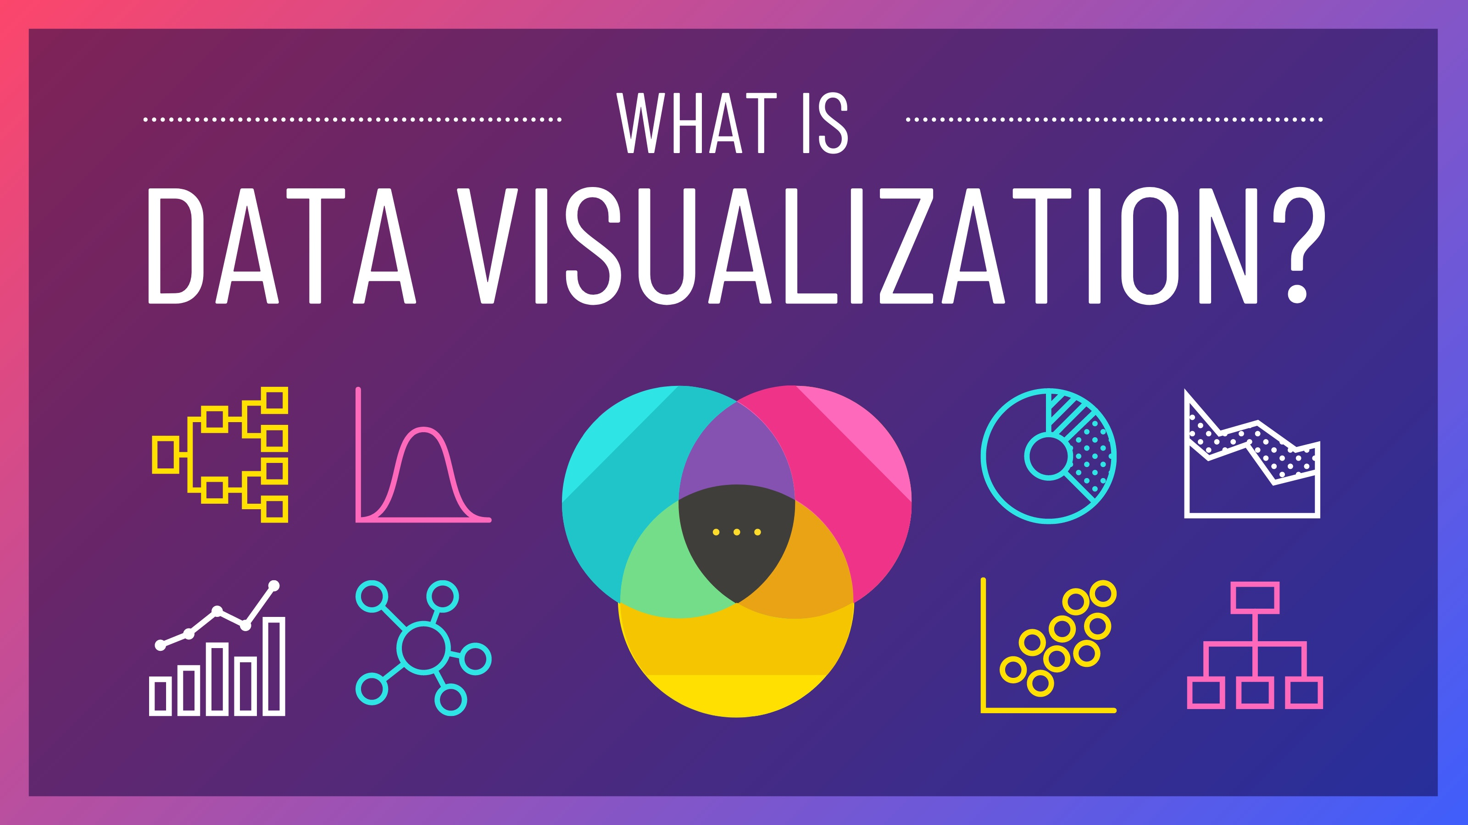
DATA VISUALIZATIONS
Data visualization is a way to show information in pictures or graphs. Instead of looking at boring numbers, you can see data in colorful charts, maps, and diagrams. It helps people understand data quickly and find patterns, making it easier to make decisions or tell stories with data. Imagine turning a long list of numbers into a colorful chart to see trends or differences at a glance. It's like using pictures to make data easier to understand!

Slide 9
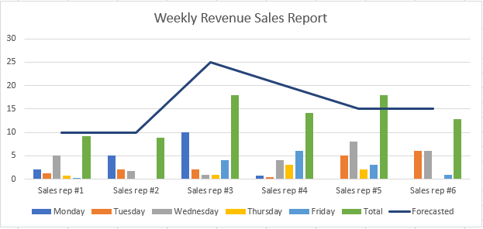
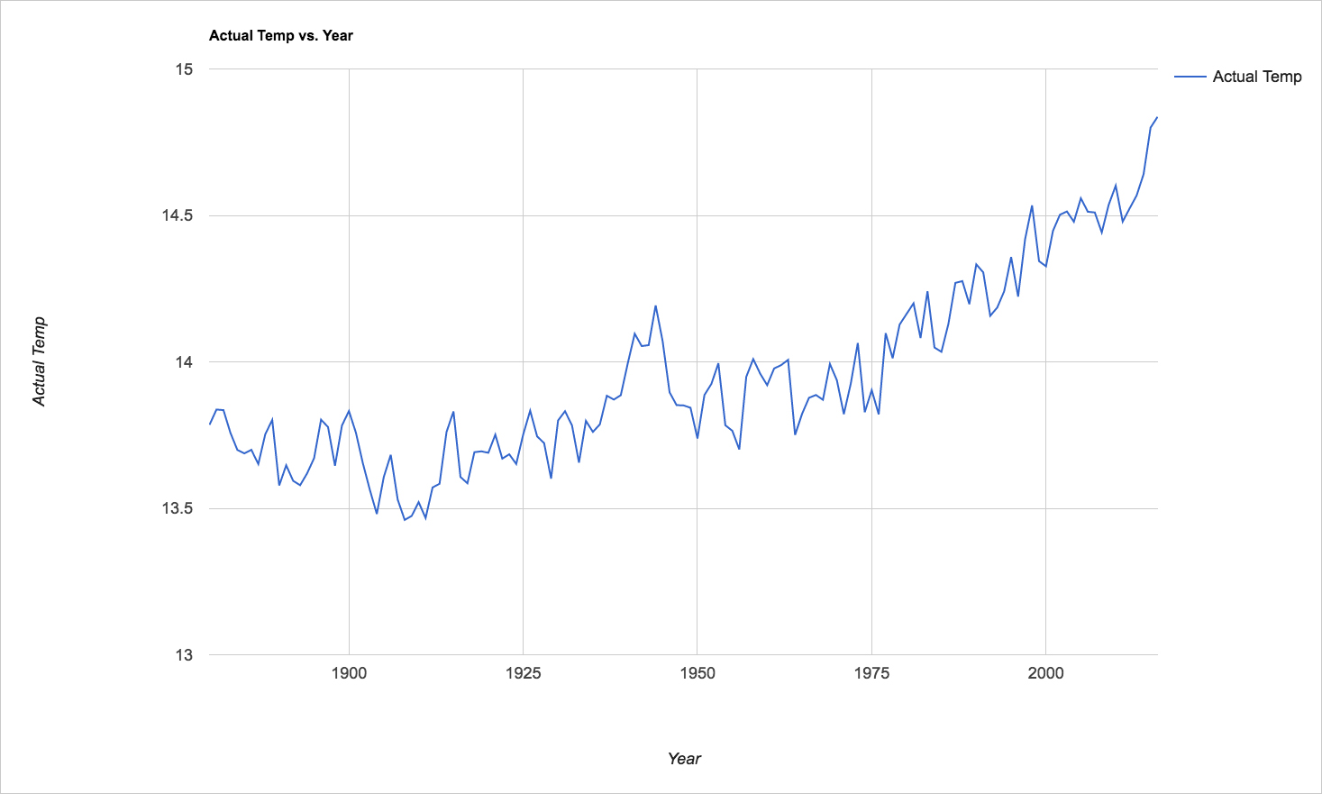
For example, you can use a bar chart to compare sales figures for different months, a line graph to show how temperatures change over time, or a map to display the locations of customers. These visuals help you see patterns, trends, and relationships in the data quickly.
Data visualization is important because it helps people make sense of information, find insights, and make informed decisions. It's like telling a story with pictures, making data more engaging and informative.

Slide 10
Bar Chart: Uses bars to represent and compare data categories. Good for showing comparisons and trends.
Line Chart: Displays data points connected by lines. Useful for showing trends or changes over time.
Pie Chart: Divides a circle into slices to represent parts of a whole. Shows proportions and percentages.
Scatter Plot: Uses points to show how two variables relate. Helps identify relationships and outliers.
Histogram: Displays data distribution in bars. Useful for understanding data patterns and frequencies.
Heatmap: Uses colors to represent data values in a grid. Shows patterns and relationships in large datasets.
Box Plot: Illustrates the distribution of data using quartiles. Helps identify outliers and data spread.
Map: Visualizes data on a geographical map. Useful for showing spatial patterns and locations.
Treemap: Divides a rectangle into smaller rectangles to represent hierarchical data. Useful for displaying structured data.
Bubble Chart: Uses bubbles of varying size to show data relationships. Useful for comparing three variables at once.

Slide 11
a graphical representation of carrier scheduled flights in numbers and percentages using two subplots
f, ax = plt.subplots(1, 2, figsize=(20, 10)): This line creates a matplotlib figure (f) with two subplots arranged in one row and two columns. It also specifies the figure size.
df['carrier'].value_counts().plot.pie(autopct='%1.2f%%', ax=ax[1], shadow=False): This line creates a pie chart on the second subplot (ax[1]) using the value counts of the 'carrier' column from your DataFrame df. The autopct='%1.2f%%' argument displays the percentages with two decimal places on the pie chart. The shadow=False argument removes the shadow effect from the pie chart.
ax[1].set_title('Flight % of Carrier'): This sets the title for the second subplot.
ax[1].set_ylabel(''): This removes the y-axis label from the second subplot, typically used when displaying a pie chart.
sns.countplot('carrier', order=df['carrier'].value_counts().index, data=df, ax=ax[0]): This line creates a countplot (bar plot) on the first subplot (ax[0]) to display the frequency distribution of carriers. The order argument ensures that the bars are ordered based on the carrier's frequency count.
ax[0].set_title('Frequency Distribution of Carriers'): This sets the title for the first subplot.
ax[0].set_ylabel('Number of Flights'): This sets the y-axis label for the first subplot.
plt.show(): This displays the entire figure with both subplots.

Slide 12
flight count and percentage based on origin
origin_count = df['origin'].value_counts(): This line counts the number of flights originating from each location (origin) in your DataFrame df and stores the result in the origin_count Series.
f, ax = plt.subplots(1, 2, figsize=(20, 10)): This line creates a matplotlib figure (f) with two subplots arranged in one row and two columns. It also specifies the figure size.
df['origin'].value_counts().plot.pie(autopct='%1.2f%%', ax=ax[1], shadow=False): This line creates a pie chart on the second subplot (ax[1]) using the value counts of the 'origin' column from your DataFrame df. The autopct='%1.2f%%' argument displays the percentages with two decimal places on the pie chart. The shadow=False argument removes the shadow effect from the pie chart.
ax[1].set_title('Percentage of Flights from Origin'): This sets the title for the second subplot.
ax[1].set_ylabel(''): This removes the y-axis label from the second subplot, typically used when displaying a pie chart.
sns.countplot('origin', order=df['origin'].value_counts().index, data=df, ax=ax[0]): This line creates a countplot (bar plot) on the first subplot (ax[0]) to display the frequency distribution of flights from different origins. The order argument ensures that the bars are ordered based on the origin's frequency count.
ax[0].set_title('Frequency Distribution of Flights from Origin'): This sets the title for the first subplot.
ax[0].set_ylabel('Flight Count'): This sets the y-axis label for the first subplot.
plt.show(): This displays the entire figure with both subplots.

Slide 13
mean departure delay varies throughout the day
df.loc[df.hour == 24, 'hour'] = 0: This line replaces the 'hour' values that are equal to 24 with 0 in your DataFrame. This is a common approach to handle data where the hour is represented as 24 to represent midnight, but you want to use 0 instead for consistency with a 24-hour clock.
delay_grp = df.groupby(['hour'], as_index=False).agg({'dep_delay':'mean'}): This line groups your DataFrame by the 'hour' column and calculates the mean departure delay for each hour. The result is stored in the delay_grp DataFrame with two columns: 'hour' and 'dep_delay'.
delay_grp['dep_delay'].plot(): This line creates a line plot of the 'dep_delay' column from the delay_grp DataFrame. It shows how the mean departure delay changes over the hours of the day.
plt.xlabel('Hour'): This sets the label for the x-axis to 'Hour'.
plt.ylabel('Mean departure delay'): This sets the label for the y-axis to 'Mean departure delay'.
plt.show(): This displays the line plot.
The resulting plot should show how the mean departure delay varies throughout the day, allowing you to see if there are any patterns or trends in departure delays by the hour.
The commented-out line #df['dep_delay'].hist(by=df['hour']) appears to be an attempt to create histograms of departure delays grouped by hour, but it's currently commented out. If you want to create histograms, you can uncomment this line and run it to see the distribution of departure delays for each hour.

Slide 14
mean arrival delay for each month
delay_mon_grp = df.groupby(['month'], as_index=False).agg({'arr_delay':'mean'}): This line groups your DataFrame df by the 'month' column and calculates the mean arrival delay for each month. The result is stored in the delay_mon_grp DataFrame with two columns: 'month' and 'arr_delay'.
delay_mon_grp['arr_delay'].plot(): This line creates a line plot of the 'arr_delay' column from the delay_mon_grp DataFrame. It shows how the mean arrival delay changes over the months.
plt.xlabel('Month'): This sets the label for the x-axis to 'Month'.
plt.ylabel('Mean arrival delay'): This sets the label for the y-axis to 'Mean arrival delay'.
plt.show(): This displays the line plot.

Slide 15
Logarithmic scaling (log scaling)
Logarithmic scaling (log scaling) is a mathematical transformation applied to data or axes in visualizations, and it serves several purposes:
1. **Compressing Data**: Logarithmic scaling compresses a wide range of values into a smaller range. This can be especially useful when dealing with data that spans multiple orders of magnitude. It makes it easier to visualize and compare data points that differ significantly in magnitude.
2. **Highlighting Patterns**: Log scaling can reveal patterns and trends in data that might be obscured by linear scaling. For example, exponential growth or decay processes often appear as straight lines on a logarithmic scale.
3. **Emphasizing Small Values**: Log scaling can emphasize small values that might be overshadowed by larger values on a linear scale. This can be important when analyzing data with outliers or when you want to focus on variations in the lower end of the data range.
4. **Dealing with Skewed Data**: Logarithmic scaling can help when dealing with data distributions that are highly skewed, where most data points are clustered at one end of the scale. It can make the distribution appear more symmetric.
5. **Multiplicative Effects**: Logarithmic scaling represents multiplicative effects as additive effects. In other words, when you take the logarithm of data points, multiplication in the original data becomes addition in the transformed data, which can simplify certain calculations.

Slide 16
Common situations where logarithmic scaling is used include:
- **Financial Data**: Stock prices, which often exhibit exponential growth or decay, are frequently plotted on a logarithmic scale.
- **Scientific Data**: Logarithmic scales are common in scientific graphs, such as those used to represent earthquake magnitudes (Richter scale) or pH levels.
- **Exponential Growth**: Data related to exponential growth, such as population growth or compound interest, can be more easily visualized and analyzed using logarithmic scales.
- **Geospatial Data**: When mapping data that spans large geographic areas, logarithmic scales can be used to account for the vast differences in scale, especially in population or economic data.
- **Signal Processing**: Logarithmic scaling is used in signal processing to visualize frequency spectra and amplitude responses.
In summary, logarithmic scaling is a valuable tool in data visualization and analysis for handling data with a wide range of values, emphasizing certain aspects of the data, and revealing underlying patterns or trends that might not be apparent on a linear scale. It can help make data more interpretable and highlight important features.

Slide 17
Splitting data into a training set and a test set
Splitting data into a training set and a test set is like having two separate groups of students when preparing for an exam.
1. **Training Set (Preparation):** This is the group of students you use to study and learn from. You give them lots of practice questions and problems to solve. They make mistakes, learn from them, and get better over time. You, as a teacher, can evaluate how well they are doing during this process.
2. **Test Set (Exam):** This is the group of students you use to see how well you've taught the material. You give them a new set of questions they've never seen before, and they have to solve them without any help. This group helps you understand if your teaching (or your model in the case of data) is effective in solving new problems.

Slide 18
In the context of machine learning:
- **Training Set:** You use it to train your machine learning model. The model learns patterns and relationships in the data, just like students learn from practice questions.
- **Test Set:** You use it to evaluate how well your model can make predictions on new, unseen data. This helps you assess if your model is likely to perform well in real-world situations.
The goal is to have a model that not only performs well on the data it was trained on (the "training set") but also on new, unseen data (the "test set"). This way, you can be more confident that your model will work effectively in the real world, just like a teacher wants to make sure their students can solve new exam questions based on what they've learned during practice.

Slide 19
Split the data into training and testing sets:
Import train_test_split from sklearn.model_selection.
This function is used to split your dataset into training and testing sets.
Define your features (X) and target variable (y):
X: This is your feature matrix, which contains all the independent variables (columns) that you'll use to make predictions.
In this case, you're dropping the 'dep_delay' column from your DataFrame Tdf, which suggests that you want to use all other columns as features.
y: This is your target variable, which is the column you're trying to predict or model. In this case, it's 'dep_delay,' representing departure delay.
Split the data into training and testing sets:
X_train and y_train: These will hold the feature and target variables for your training dataset.
You're using 80% of your data for training (specified by test_size=0.2), meaning the remaining 20% will be used for testing.
X_test and y_test: These will hold the feature and target variables for your testing dataset.
random_state: You've set random_state=42. This is an optional parameter that ensures the randomness of the data split remains the same each time you run the code.
It's useful for reproducibility, as it guarantees the same split if you use the same random state.

Slide 20
Evaluation metrics for regression models like linear regression.
These are commonly used evaluation metrics for regression models like linear regression. They help you assess how well your regression model is performing in terms of making predictions on continuous numerical data. Here's a brief explanation of each metric:
1. **Mean Squared Error (MSE):**
- MSE measures the average squared difference between the predicted values and the actual values in your dataset.
- It gives more weight to larger errors, making it sensitive to outliers.
- MSE is calculated as the sum of squared errors divided by the number of data points.
- Formula: MSE = Σ(actual - predicted)^2 / n
2. **Root Mean Squared Error (RMSE):**
- RMSE is the square root of the MSE and provides a more interpretable metric because it's in the same units as the target variable.
- Like MSE, it penalizes larger errors more heavily and is also sensitive to outliers.
- RMSE is calculated as the square root of the MSE.
- Formula: RMSE = √(MSE)

Slide 21
3. **Mean Absolute Error (MAE):**
- MAE measures the average absolute difference between the predicted values and the actual values.
- It gives equal weight to all errors and is less sensitive to outliers compared to MSE and RMSE.
- MAE is calculated as the sum of absolute errors divided by the number of data points.
- Formula: MAE = Σ|actual - predicted| / n
4. **R-squared (R2) Score:**
- R2 score, also known as the coefficient of determination, quantifies the proportion of the variance in the dependent variable (target) that is predictable from the independent variables (features) in your model.
- It provides an indication of how well your model fits the data.
- R2 score ranges from 0 to 1, where 0 indicates that the model does not explain any variance, and 1 indicates that the model explains all the variance.
- Formula: R2 = 1 - (SSR / SST), where SSR is the sum of squared residuals and SST is the total sum of squares.
In summary:
- **MSE** and **RMSE** focus on the magnitude of errors, with RMSE providing a more interpretable value.
- **MAE** is less sensitive to outliers and represents the average absolute error.
- **R2 score** assesses how well your model explains the variability in the target variable, with higher values indicating a better fit.
The choice of which metric to use depends on your specific problem and the importance of different types of errors and model interpretability. Typically, lower MSE, RMSE, and MAE values and higher R2 scores indicate better model performance.

Slide 22
Variance in a target variable
In the context of the R-squared (R2) score, the "variance in the target variable" refers to the degree of variation or spread in the values of the target variable, which in our case is the departure delay.
1. **Variance**: Variance is a statistical measure that quantifies the spread or dispersion of a set of data points. In the context of departure delays, it reflects how departure delay times vary from one flight to another. A high variance indicates that departure delays are widely dispersed, meaning some flights may experience substantial delays, while others depart on time or with minimal delay. Conversely, a low variance suggests that departure delays are relatively consistent or uniform.
2. **R-squared Score Interpretation**: The R-squared (R2) score is a statistic that ranges from 0 to 1 (or 0% to 100%). It represents the proportion of the variance in the target variable (departure delay) that is "explained" or "captured" by our regression model. An R2 score of 0.87, as in our case, means that our model accounts for approximately 87% of the variability or dispersion in departure delays.

Slide 23
- In practical terms, this means that our model successfully captures a substantial portion of the reasons behind why departure delays vary across different flights.
- The remaining 13% of the variance (1 - 0.87 = 0.13 or 13%) is unexplained by our model. These unexplained factors could include random fluctuations, unobserved variables, or measurement error.
3. **Model Fit**: An R2 score of 0.87 is considered relatively high, indicating that our linear regression model is a good fit for the data. It suggests that the features (independent variables we have used in our model are informative and have a strong association with departure delay.
In summary, the variance in departure delay represents the natural variability or differences in delay times across flights, and the R2 score quantifies how much of this variability our model can account for. An R2 score of 0.87 suggests that our model explains a substantial portion of the departure delay variation, indicating a good fit to the data. However, it's important to remember that not all factors contributing to departure delays may be included in our model, and some variability may remain unexplained.

Slide 24
Intercept
In a linear regression model, the goal is to find the relationship between the independent variables (features) and the dependent variable (target), assuming that this relationship can be approximated by a linear equation. The equation for a simple linear regression model with one independent variable can be written as:
\[y = b0 + b1 * x\]
In this equation:
- \(y\) is the dependent variable (departure delay in our case).
- \(x\) is the independent variable (one of our features).
- \(b0\) is the intercept.
- \(b1\) is the coefficient for the independent variable \(x\).
Now, let's address the interpretation of the intercept (\(b0\)):
1. **Intercept's Role**: The intercept represents the estimated value of the dependent variable (departure delay) when all the independent variables are set to zero. However, this interpretation may not always make sense in the context of our dataset.
2. **Context and Scaling**: In many real-world scenarios, setting all independent variables to zero may not have a meaningful interpretation. For example, if one of our independent variables is "distance traveled" and another is "airline code," it doesn't make sense to set both to zero.

Slide 25
3. **Constant Offset**: The intercept is essentially a constant offset in the linear equation. It accounts for the part of the dependent variable's value that cannot be explained by the linear relationship with the independent variables. It's the value of departure delay that you would expect when all other factors (independent variables) are zero.
4. **Scaling**: The interpretation of the intercept also depends on the scaling of our features. If our features have been standardized (mean-centered and scaled by their standard deviations), the intercept represents the expected departure delay when all features are at their mean values.
In our specific case, the intercept of approximately 4.645 represents the estimated departure delay when all the independent variables (features) in our model are at their reference values or "zero" values. However, the exact interpretation of this value may not be straightforward without knowing the specific context and scaling of our features.
It's often more meaningful to interpret the coefficients of the independent variables (the values you see in the "Coefficients" output) because they tell you how a one-unit change in each feature affects the departure delay, while holding all other features constant. The intercept is more of a mathematical component of the linear equation rather than something with a direct, intuitive interpretation in many practical cases.

